Slide 1
Traditional vs metadata-driven Apps common problems different solutions
Ioannis Rousochatzakis, Publications Office, 13/12/2022

Slide 2
Agenda
“Standard features” of eForms applications
SDK roadmap for 2023
Coping with change
Discussion

Slide 3
Before we start
Recent documentation updates
Reorganized content
Equal weight on traditional and metadata-driven development
Added developer guides
Search improvements (ongoing)
Current efforts:
Iron-out details in the SDK
Get the TED API together
Improve our communication with developers
Plan ahead for 2023

Slide 4
“Standard Features” of eForms applications
Fill-in forms
Save XML
Validate XML
Visualise notices
Submit notices
Validate in-form
Upgrade, Switch SDK

Slide 5
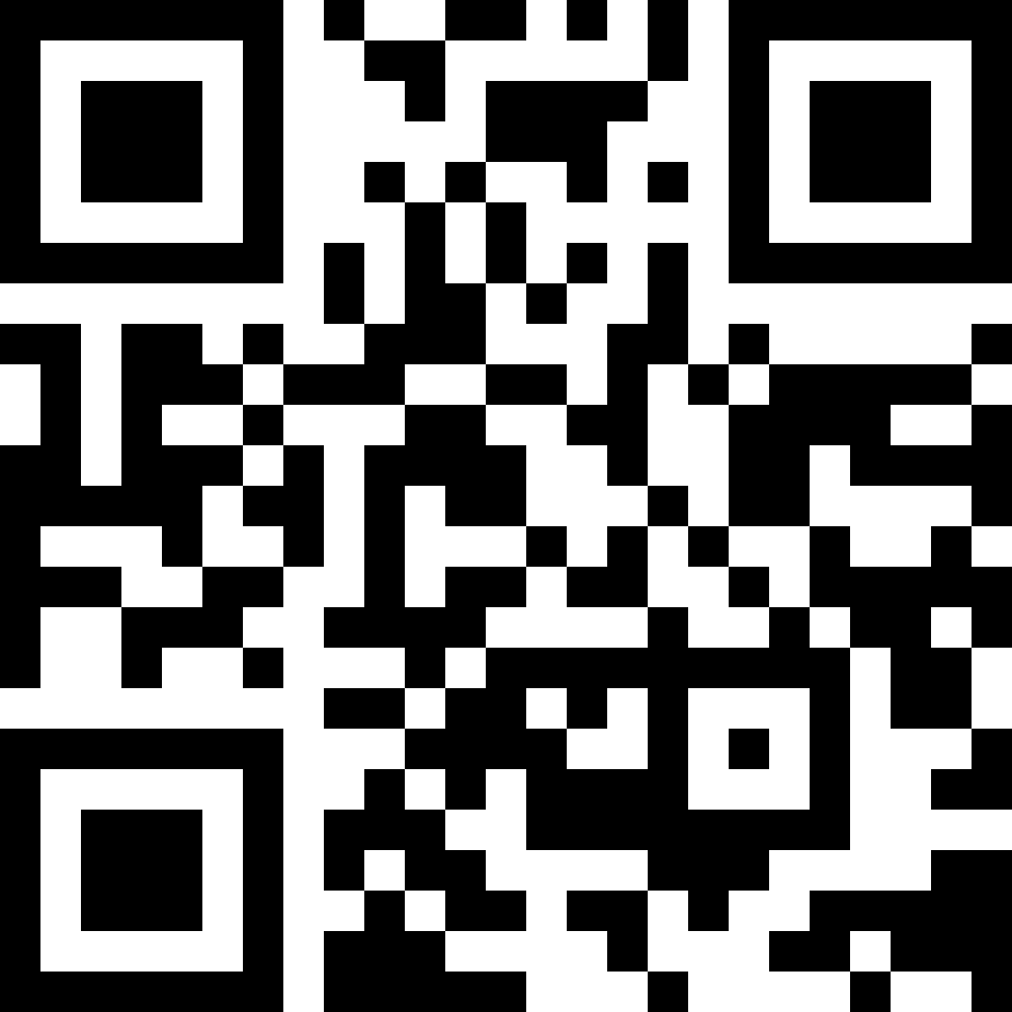
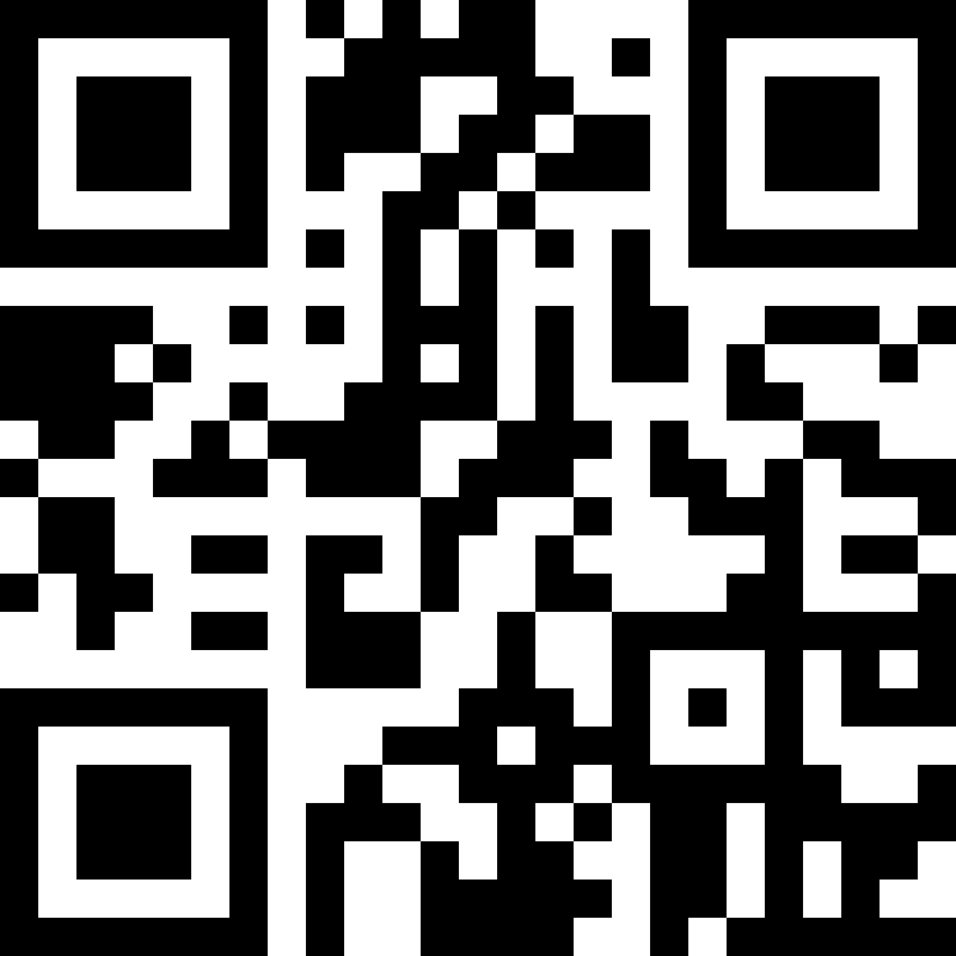
How to create the notice forms?
Traditional applications
Hardcoded solution
Pros:
You are in full control (it’s your own solution)
Cons:
Rigid
High maintenance (follow and apply updates manually)
Metadata-driven applications
Reuse SDK notice type definitions (a.k.a. visual model)
Pros:
Hassle-free updates (mostly)
Sample code available (see Notice Editor sample application)
Cons:
MS tailoring support not there yet
Documentation https://europa.eu/!8w4Pfv
Documentation https://europa.eu/!qwfKnT

Slide 6
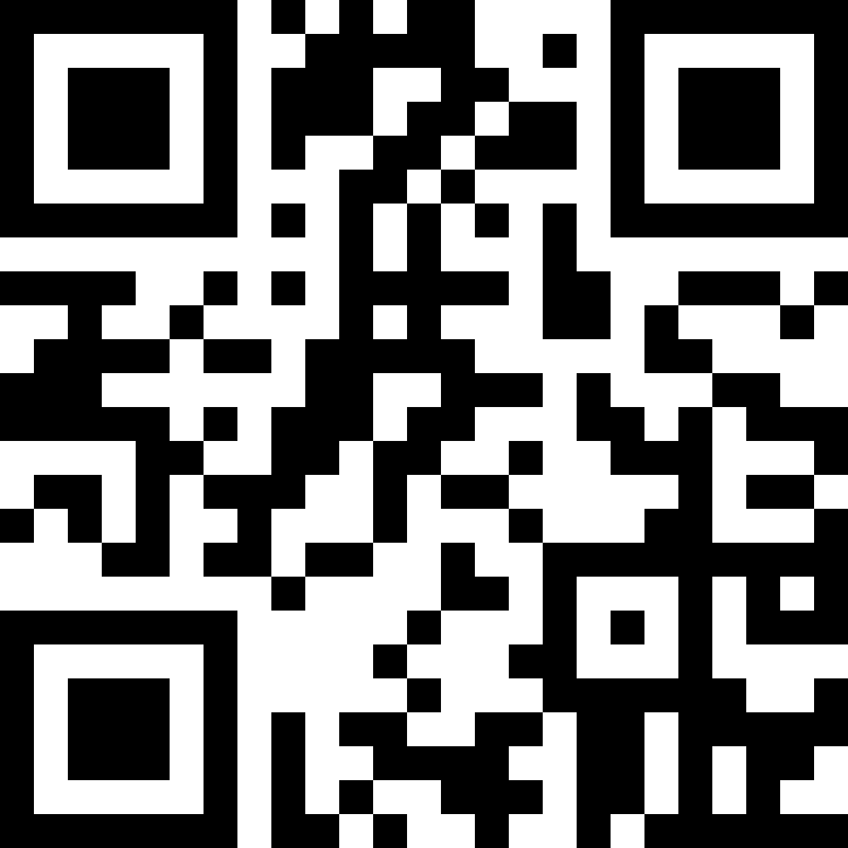
How to create the notice XML file?
Traditional applications
XML from XSD (or some other hardcoded solution)
Pros:
Classic
Cons:
UBL XSDs too big and complex
XSD not enough by itself
Heavy hardcoding required
Hard to maintain
Metadata-drive applications
Form to XML transformation using the models provided in the SDK (visual -> conceptual -> physical)
Pros:
Independent of specs/schema changes (maintenance-free)
Sample code available (see Notice Editor sample application)
Cons:
(no cons)
Documentation https://europa.eu/!G4q3Yp
Documentation https://europa.eu/!qwfKnT

Slide 7
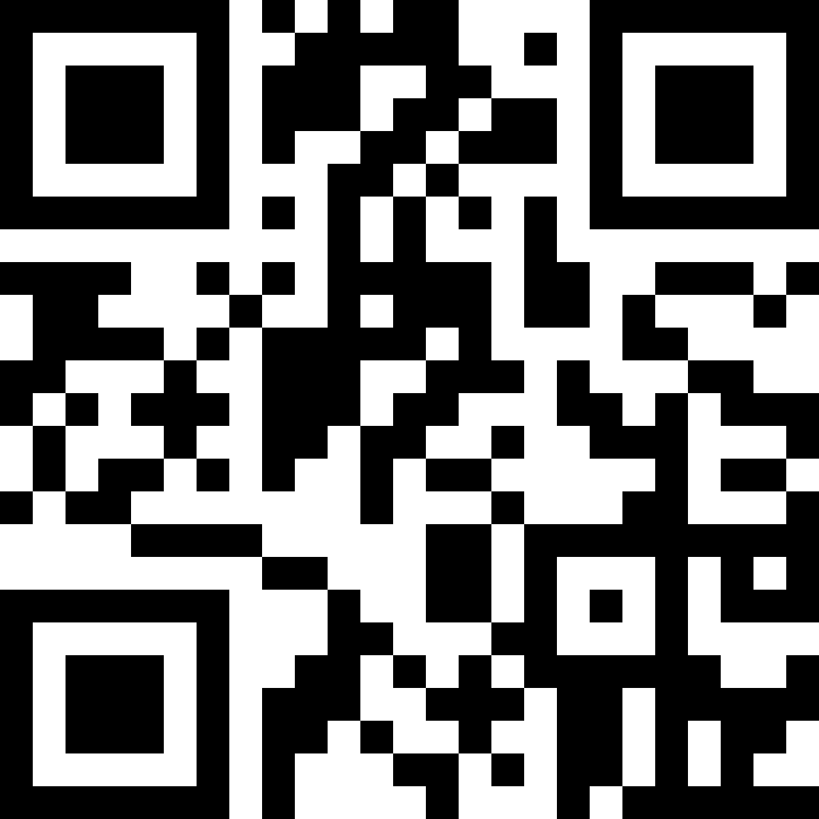
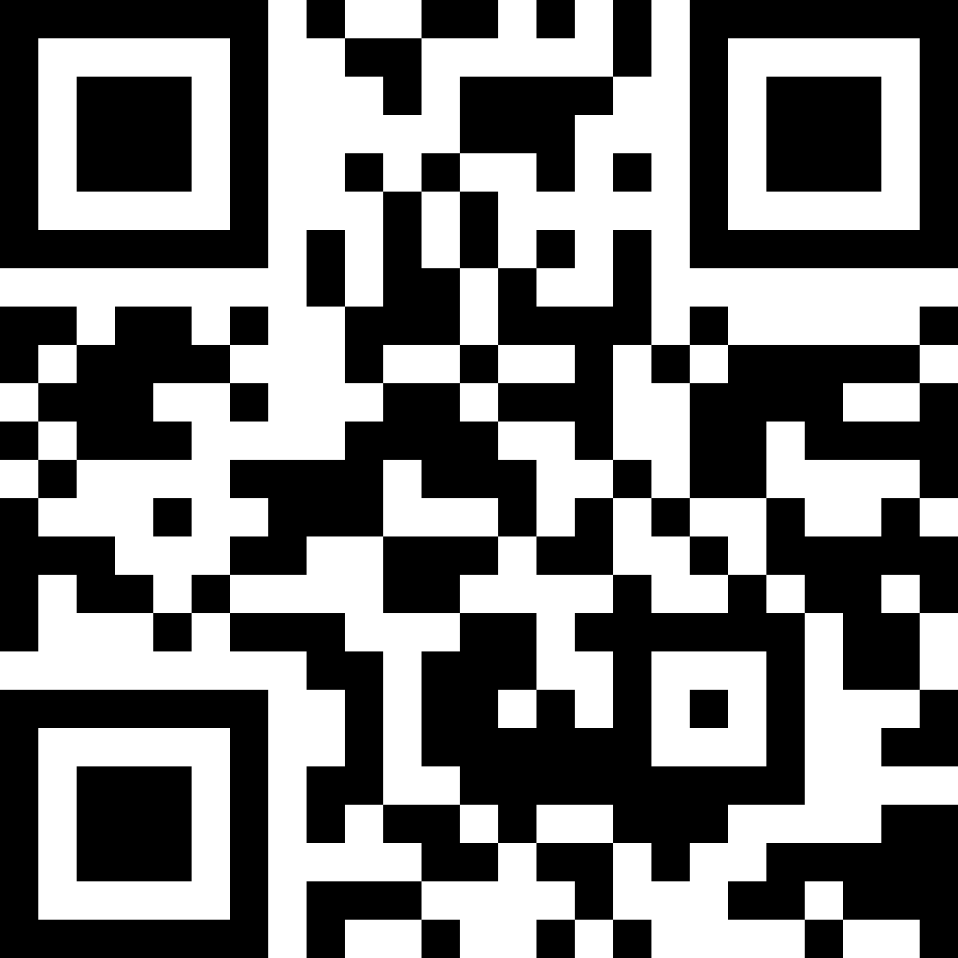
How to validate notices?
Traditional applications
Use the Validation API (a.k.a. TED CVS)
Pros:
Maintenance-free
Cons:
Validates fully formed XML notices only
Does not work offline
Metadata-driven applications
Add client-side validation (EFX constraints provided in the SDK)
Pros:
Maintenance free (mostly)
Helpful for your end-users
Cons:
You need an EFX translator
Documentation https://europa.eu/!Y47x4Q
Documentation https://europa.eu/!RWjX6b

Slide 8
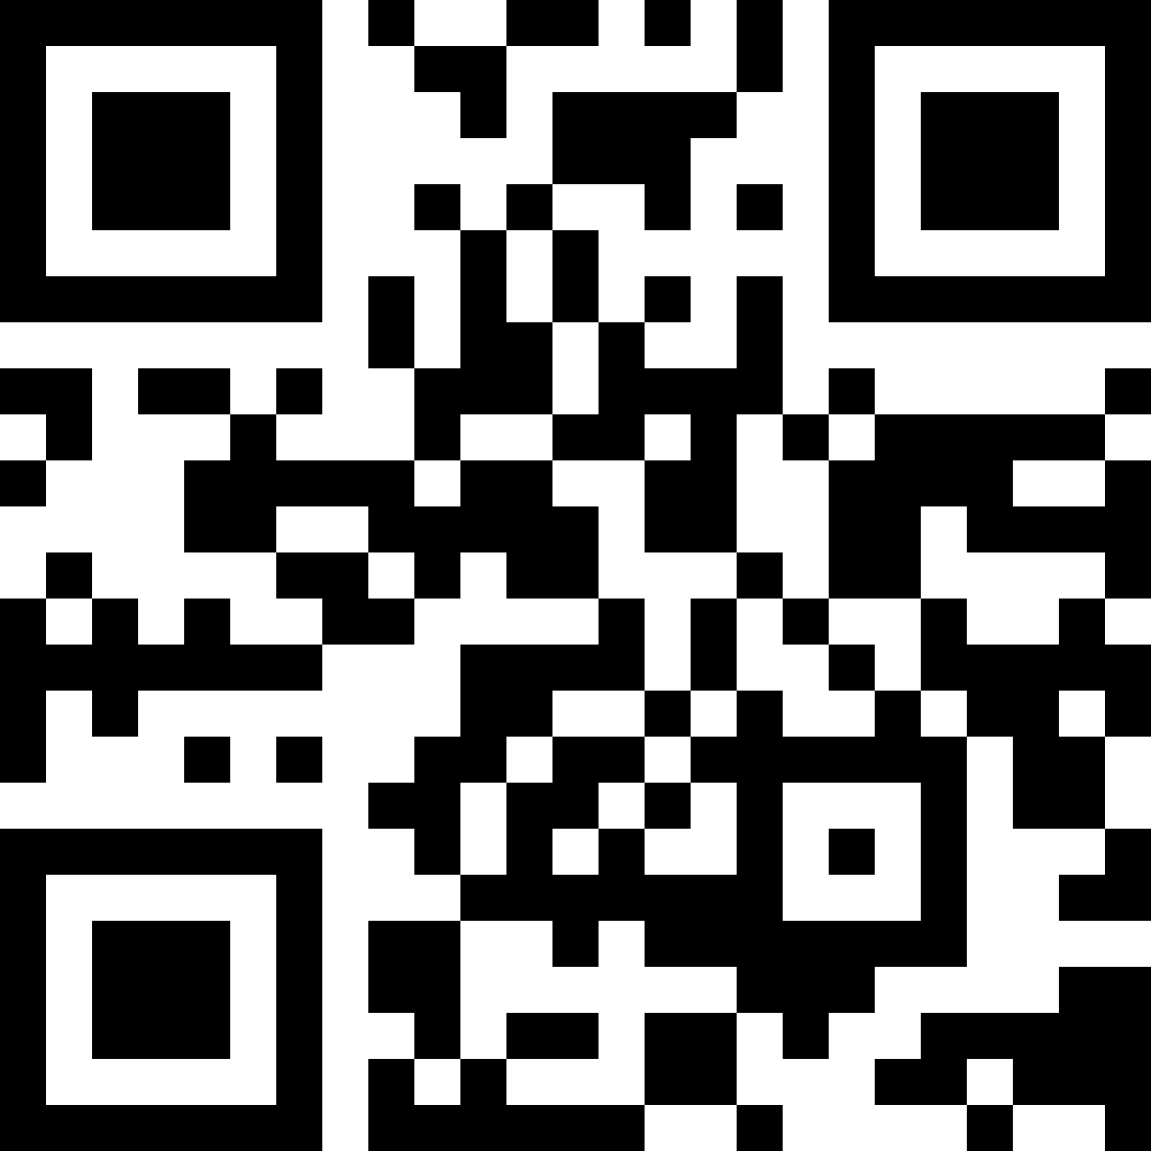
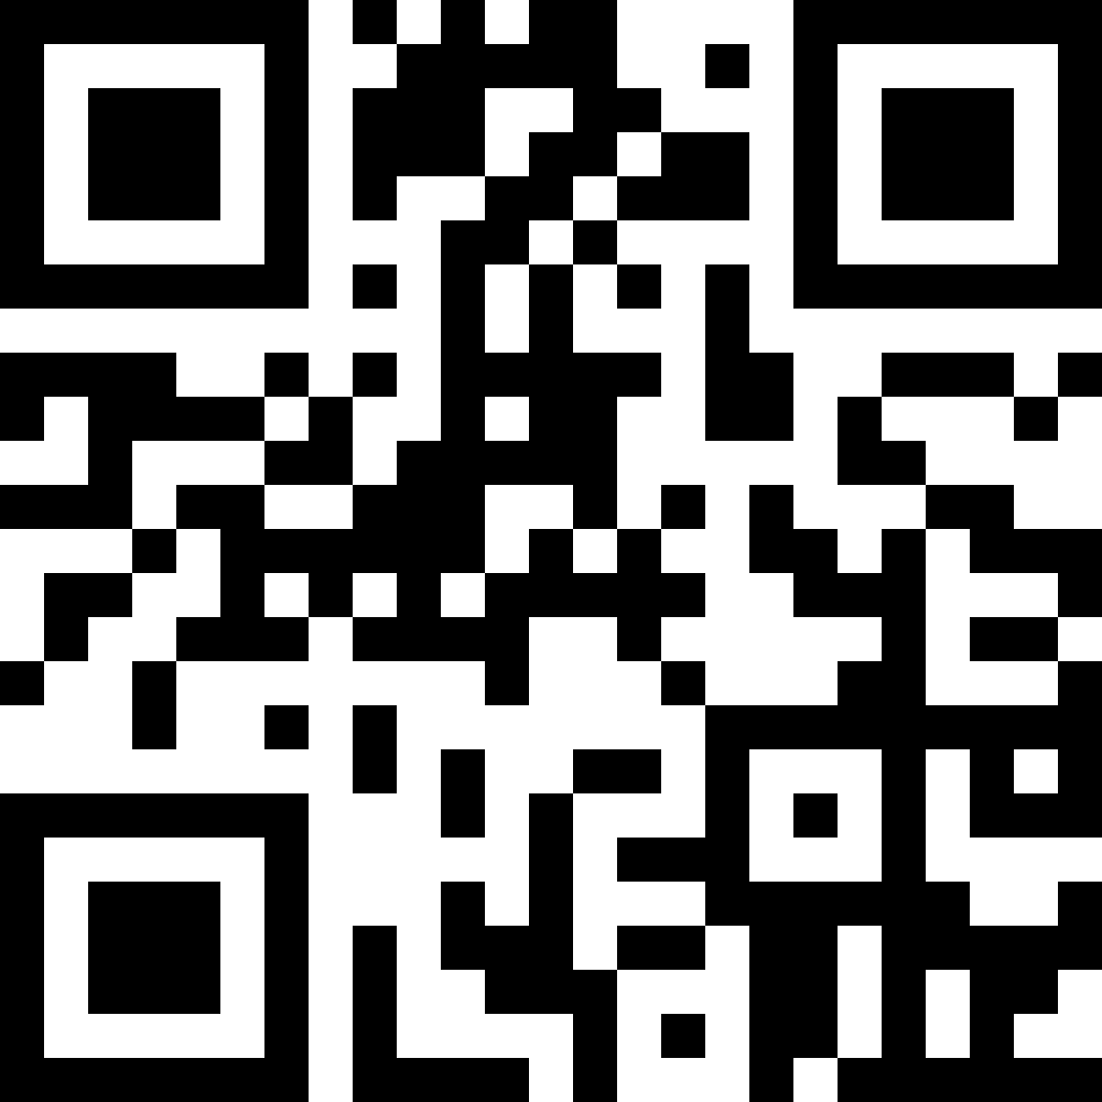
How to visualise a notice?
Traditional applications
Use the TED Visualisation API (a.k.a. TED Viewer 2022)
Pros:
Maintenance-free
Cons:
You can’t customise it
Does not work offline
Metadata-driven applications
Reuse View Templates
Pros:
Maintenance-free
Better integration in your apps
You can customise them
Cons:
You need an EFX template translator (see Notice Viewer Sample application)
Documentation https://europa.eu/!YptqFC
Documentation https://europa.eu/!NNP696

Slide 9
For metadata-driven applications only
Consuming a new SDK
Use the eForms Core Library (directly or for inspiration)
Make sure to import the SDK into a data store that best fits your runtime.
For a while you may discover that even minor versions may have an impact on your system (because both the SDK and your system as still too young)
Work with us to iron-out such issues until they disappear. (give us feedback and suggestions in GitHub)
Switching between SDK versions
Different notices will be created using different versions of the SDK; To handle them your app needs to operate with the proper SDK each time.
Use the eForms Core Library (directly or as an inspiration)
See also how the EFX Toolkit and the Sample applications solve the same issues
To switch between minor versions you need to pool them (only keep the latest patch)
You need different versions of your “importer” for different major versions of the SDK.

Slide 10
“Standard features” of eForms applications (recap)
Standard Features | Traditional Applications | Metadata-driven Applications
Fill-in a new notice form | ✶ | SDK
Edit an older notice | ✶ | SDK
Save as XML | ✶ | SDK
Validate a notice (XML) | TED API / SDK | TED API / SDK
Submit a notice | TED API | TED API
Validate while filling-in the notice | ✶ | SDK
Visualise a notice | TED API | TED API / SDK
Import a new SDK | N/A | eForms Core Library
Switch between SDK versions | N/A | eForms Core Library
✶ = read the docs, design your own solution

Slide 11
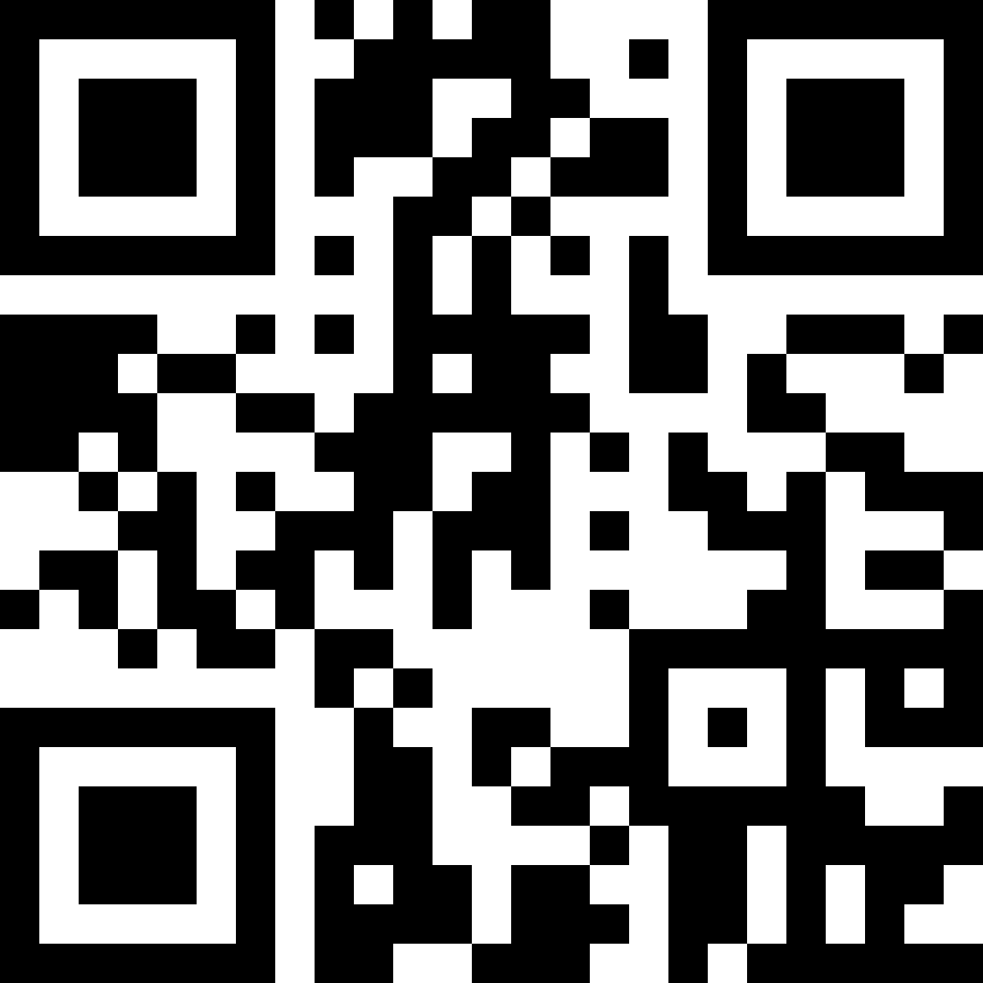
TED API
Available APIs
Publication API
Validation API
Visualisation API
Search API
Status
Work on API still ongoing
TED API v2 coming soon for long-term
Current API will not be discontinued
Some APIs will be added to help orchestrate SDK release roll-out
Documentation https://europa.eu/!J8JCbF

Slide 12
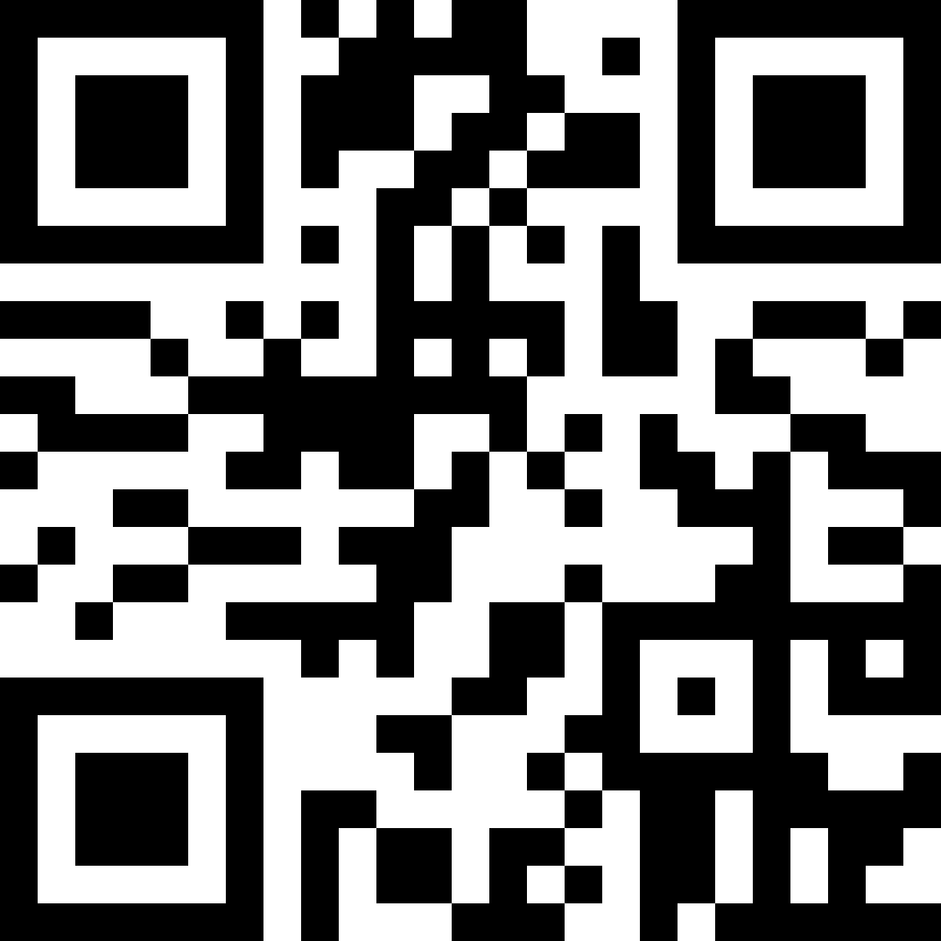
Coping with change - Part I
How changes are identified
A version number identifies each version of the eForms Specification.
We use Semantic Versioning (major.minor.patch)
The same version number is assigned to the eForms SDK and the eForms Documentation
How changes are introduced
A new version of the SDK is published on GitHub
A new version of the documentation is published on https://docs.ted.europa.eu
An announcement is published on SIMAP and GitHub discussions.
More on versioning https://europa.eu/!VR3bbH

Slide 13
Coping with change – Part II
Causes of change
changes in the regulation
need to fix mistakes
need to address security or privacy concerns
general evolution of information systems
general evolution of business domain
What may change
The eForms schema
The business rules
The authority tables

Slide 14
Impact of change
Traditional applications
Major versions (2.0.0, 3.0.0 etc.)
Same as any other change (see next slide)
Minor versions (x.1.0, x.2.0 etc.)
Same as any other change (see next slide)
Patches (x.x.1, x.x.2 etc.)
Same as any other change (see next slide)
Metadata-driven applications
Major versions (2.0.0, 3.0.0 etc.)
Update code that reads the SDK
Minor versions (x.1.0, x.2.0 etc.)
No impact (mostly)
Patches (x.x.1, x.x.2 etc.)
No impact

Slide 15
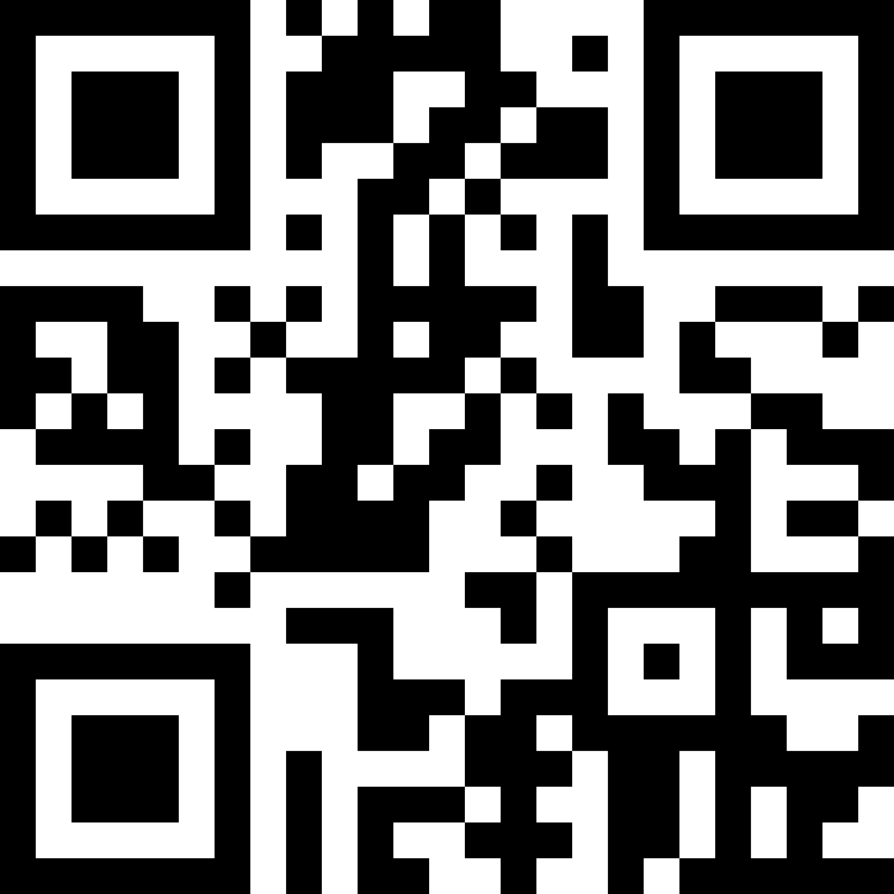
Impact of change - Traditional apps
Filling-in a new notice
Manually update your forms
Editing an existing notice
No impact (depends on your implementation)
Validating a notice
No impact if you only use Validation API
Saving a notice XML
Manually update your code
Visualising a notice
No impact if you only use Visualisation API
Dealing with change
https://europa.eu/!H68YYM

Slide 16
SDK roadmap through 2023
SDK 1 will continue being updated and supported all the way through October 2023.
Roughly one minor release per month until June.
No releases after June (unless absolutely necessary)
SDK 2 will be introduced in March (released by May)

Slide 17
SDK 2.0.0
We need to do some improvements in EFX (no impact on traditional applications)
We will add some information to make it easier for metadata-driven applications to consume the SDK. (no impact on traditional applications)
We want to make field names friendlier (don’t worry we’ll also keep the existing ones)
No additional impact on traditional applications
Metadata-driven application developers will be kept the loop to make transition as smooth as possible.
SDK 1 will remain active and will be maintained in parallel.

Slide 18
Other topics to discuss
What about Non-Java developers?
Tell us what you need.
Start your questions/feedback in Slido with #non-java so that it stands out.
Documentation
What is the most important improvement we can do in the documentation?
GitHub Discussions
Are you all aware of them?
Do they work for you?
Any suggestions for improvements in communication?

Slide 19
Thank you
Here are some hashtags for the topics we talked about. Use them in your questions/feedback to help us run through them faster by topic.
#change #xml #forms #forum #docs #non-java #validation #api #viewer #sdk2

