Slide 1
Current status of eforms Implementation
eForms 2nd technical workshop – 29 September 2022
Karl Ferrand – TED unit - Publications Office of the EU

Slide 2
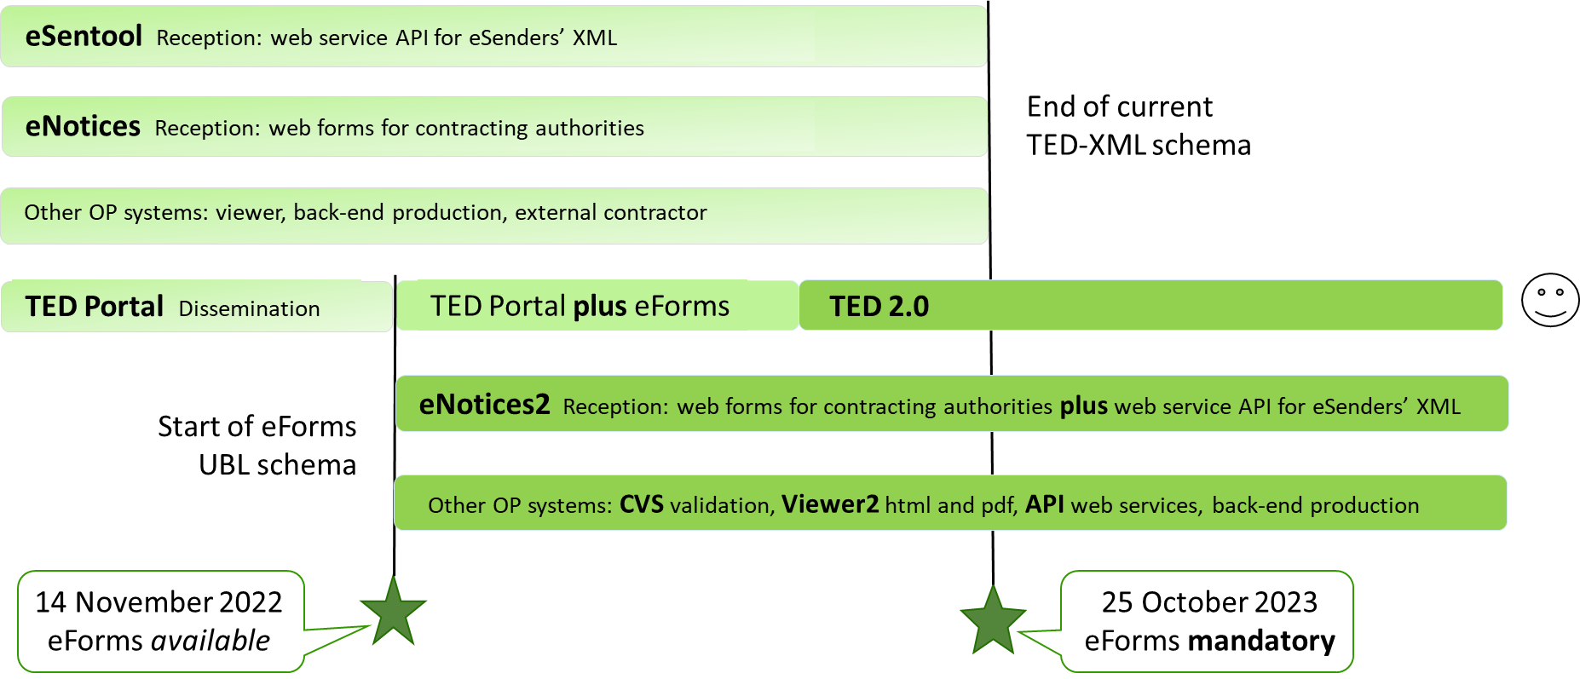
eForms implementation at the Publications Office
Status of SDK
Status of TED applications
2022 regulation amendment
Next steps and issues

Slide 3
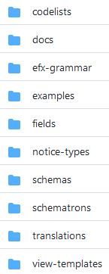
TED Docs, Software Development Kit and code
Docs: https://docs.ted.europa.eu
FAQs, preview environment and documentation for each SDK version
New metadata reference viewer for business terms, business rules and codelists
SDKs: 0.7 in July, 1.0 in August, 1.1 in September https://github.com/OP-TED/eForms-SDK
New notice type definitions
Changes and extensions to eForms Expression Language (EFX), schema, schematron rules, field properties, viewer templates, labels/translations, codelists…
Code on https://github.com/OP-TED
TED-XML converter – from current CN and CAN forms to (partial) eForms XML
Sample notice viewer app – generate HTML using EFX view-templates
Sample notice editor app – create and edit eForms XML using SDK notice-types
EFX toolkit for Java

Slide 4
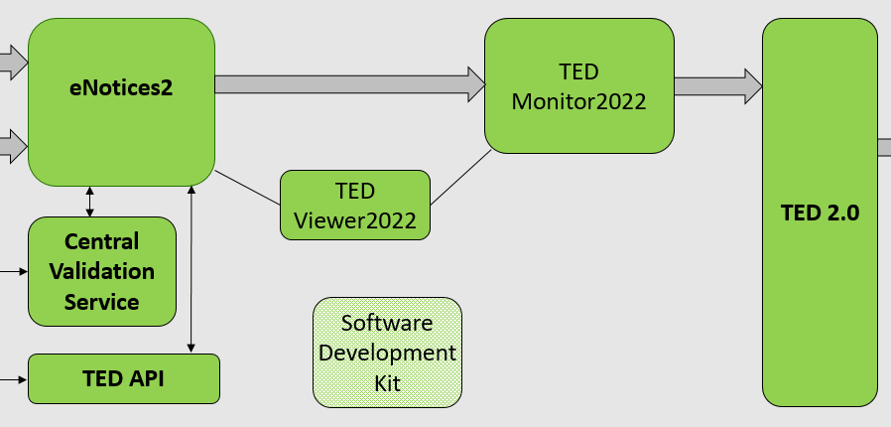
Status of TED applications
Preview environment with all applications - but not finalised or integrated
New releases in mid/late-October
eNotices2: OP is testing release with SDK 1.0 and removing blocking issues
Go-live focus on API, front-end improvements after November
CVS: application finalised – but rules are still evolving
TED Developer Portal (TEDAPI): finalised – to extend with developer profiles
TED Viewer 2022: testing version using SDK 1.0 view-templates
TED Monitor 2022: testing final version, preparing for production
TED: testing final version, preparing for production end October
Publication number will go from 6 to 8 digits, also for TED-XML
(TED 2.0: planned for summer 2023)

Slide 5
2022 amendment to eForms regulation
Public consultation closed 14 September
Member States formal meeting (ACPC committee) on 10 October
Publish in OJ (just) before 14 November
Main regulation clarifies (no practical impact for us all):
Repeal: “Implementing Regulation (EU) 2015/1986 is repealed with effect from 14 November 2022”
Transitional provision: “From 14 November 2022 to 24 October 2023, both the forms … may be used for the publication of notices…”
Annex changes (impact on schema, rules, codelists, templates, labels, etc)
Framework agreements, Clean Vehicles Directive, green procurement, innovative procurement, EU funding, errors, corrections, clarifications

Slide 6
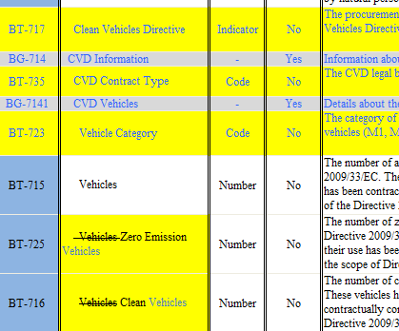
2022 amendment changes
SDK 1.1 contains most of the schema changes:
10 new business terms:
Clean Vehicle Directive: 1 indicator, 2 codes
Green procurement criteria: 1 code
EU funds: 1 text in result, 3 code+identifier+text for competition
Non-disclosure agreement: 2 indicator+text
Notice Dispatch Date eSender: 1 date
Corrections to which BTs allowed in which forms
Many description and name text improvements
Still to do in next SDKs:
Tender Ranked indicator
Framework agreement: 3 values to split estimated and maximum
Complete the changes to rules, notice-types, view-templates, labels…

Slide 7
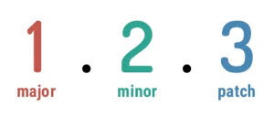
Next steps and issues at Publications Office
SDK 1.x applications in OP Acceptance (and Production) and public Preview environments
Complete developments (mainly eNotices2 front-end)
SDKs 1.2 and 1.3 in October - and then after November
Document and clean up APIs (URLs, parameters, etc)
More SDK documentation and support
Build the converter service API and extend sample applications

Slide 8
Next steps and issues at eSenders
When will each eSender switch to eForms? How to do onboarding? Survey?
Impact on:
OP processing of notices – sudden end of manual validation for certain countries
OP TED helpdesk – have the answer to eSenders and end users
TED data reusers – must adapt to consume eForms XML but depends on their markets
Buyers – once a procedure is in eForms, there’s no going back
Is national tailoring completed (and published) in all countries?
Any other (non-technical) dependencies?
Information and training for buyers and end users?

Slide 9
Thank you for your Attention Any questions?
ted@publications.europa.eu

