Slide 1
Reusing eForms
Ioannis Rousochatzakis, Publications Office, 27/09/2022

Slide 2
TED data today
Notices are stored/distributed as XML documents
Can be retrieved as individual XML documents (or sets of)
There is no publicly accessible database of notices
TED website provides search interface
  for humans
  for applications (TED Search API)
Other means of retrieving notices (ftp, csv etc.).
TED XML schemas are changing (eForms)

Slide 3
Reusing TED data (scenarios)
“Aggregate”, “Report”, “Analyse”
  Need to organise and query historical data
  Need to combine with other sources
  Need for a data-warehouse
“Republish”, “Announce”
  Individual notices
  In your own website/medium
  Limited information needed for indexing (notice “metadata”)
  Customised notice visualisation (nice to have)
Other scenarios? Please tell us…

Slide 4
Your needs as we understand them today
Fundamentals
  Download notice XML files.
  Extract all, or a subset of notice data.
A bit more advanced
  Index, data-warehouse, organise extracted data.
  Be able to visualise an individual notice in your own systems.
“Cutting edge”
  Master data identification.
  Data integration, link to other data sources.

Slide 5
How can we help you?
Several resources are already available for eForms.
However:
  Focused on establishing data collection capabilities.
  Not yet adapted for the community of reusers.
Dissemination and reuse improvements are on their way.
We see you as application developers and innovators.
We want to organise our resources and offering around your needs.
Your feedback can inform our prioritisation and focus

Slide 6
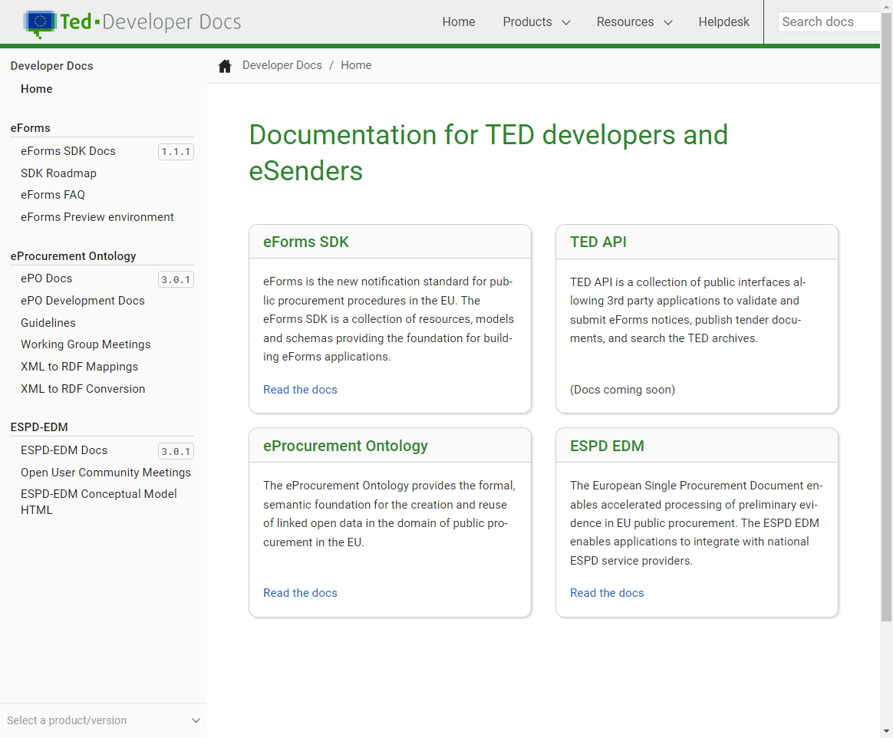
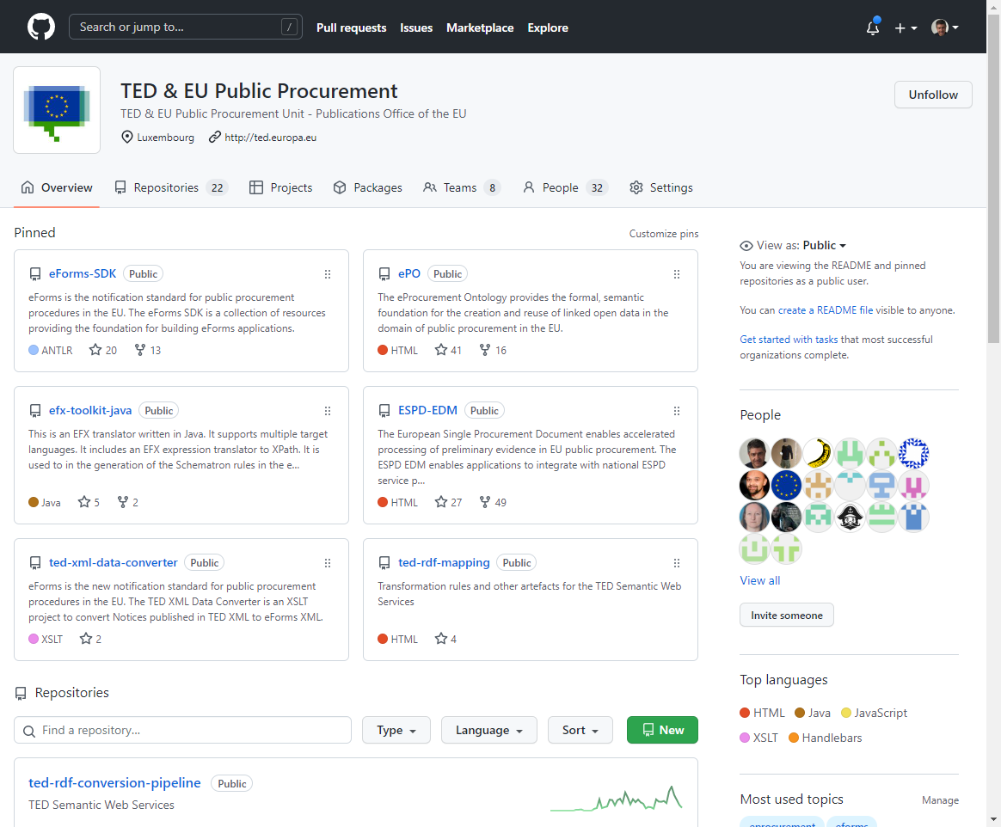
Write these down
TED Developer Documentation
  https://docs.ted.europa.eu
TED on Github
  https://github.com/OP-TED

Slide 7
Resources on Github
eForms SDK
eForms Schemas
Business Terms and Fields
Notice structure information
Templates for visualising notices
Translations of public procurement terms
Controlled vocabularies (codelists)
Example notices
Also included in the SDK
  Notice type definitions
  Schematron validation rules
SDK Versioning
  Bundles all resources necessary for creating eForms applications
Alongside the SDK
  Sample applications
  EFX Transpiler

Slide 8
Other resources on Github
eProcurement Ontology (ePO)
  The basis for publishing TED data as Linked Open Data
TED XML Data Converter
  XSL stylesheets for transforming a legacy TED XML notice to an eForms XML notice.
XML to RDF mappings & conversion pipeline
  RML mappings of TED XML to RDF and eForms XML to RDF

Slide 9
Documentation
In the TED Developer Documentation:
  Full documentation of the eForms SDK
  Full documentation of the eProcurement Ontology
  Coming soon: full documentation of TED API
You may find the documentation overwhelming.
We will try to accommodate the needs of reusers.

Slide 10
What is next
eForms goes live 14 November
Our focus will shift to:
  Stabilise and mature our new technologies.
  Help eSenders transition to eForms by October 2023.
  Open-up TED data to Semantic Web.
  Foster reuse of TED data.

Slide 11
TED Semantic Web Service
Linked Open Data
Coming Q2 2023
SPARQL endpoint
Updated daily
Historical data
Documentation coming to docs.ted.europa.eu
Sample applications coming to github

Slide 12
Thank you
Your questions/feedback please…
Remember: https://docs.ted.europa.eu + https://github.com/OP-TED

