Slide 1
The European Data Conference on Reference Data and Semantics (ENDORSE)
ELI-DL: Implementation by the European Parliament
Laura Liudvinavičiūtė, Christie Damnet – 19 October 2022
Empowering our digital Parliament

Slide 2
Overview
1
2
3
4
Background
The ambitions
Towards reusability
Our use cases
ELI-DL: Implementation by the European Parliament

Slide 3
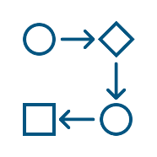
Technical interoperability
1. Background
.json
EUROPEAN PARLIAMENT
.json
.json
Aggregation
Harmonization
Enrichment
Retrieval
Storage
Data services
ELI-DL: Implementation by the European Parliament

Slide 4
Data-centric approach
1. Background
Data models remaining valid long after the application is gone.
twitter.com/SimenMunter
ELI-DL: Implementation by the European Parliament

Slide 5
Be reusable
2. The ambitions
Legal Interoperability
Organisational Interoperability
Semantic Interoperability
Technical Interoperability
... ensures that the precise format and meaning of exchanged data and information is preserved and understood throughout exchanges between parties, in other words ‘what is sent is what is understood’
EIF, Interoperability layers
ELI-DL: Implementation by the European Parliament

Slide 6
Existing ontologies and vocabularies
3. Towards reusability
EU and W3C ontologies
ORG
ELI, ELI-DL
SKOS
DC, DCTERMS
EU core vocabularies (person)
FOAF
DCAT
...
EU authority tables
corporate-body
corporate-body-classification
event
role
country
site
...
ELI-DL: Implementation by the European Parliament

Slide 7
Choice of ELI and ELI-DL
3. Towards reusability
Why? To describe legislative and non-legislative data
How? Became a member of ELI Task Force for proposing changes
ELI-DL: Implementation by the European Parliament

Slide 8
Our data and data models
3. Towards reusability
ELI-EP: Legislative and non-legislative activities and documents
EPVOC: Technical and specific metadata
ORG-EP: Data of the organization
ELI-DL: Implementation by the European Parliament

Slide 9
Some data statistics (2022)
3. Towards reusability
184
5k
3k
35m
MEPs
Organisations
*
* expected growth to > 500m
Datasets
2k
150k
Triples
Activities
Documents
ELI-DL: Implementation by the European Parliament

Slide 10
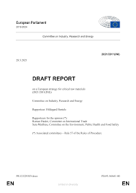
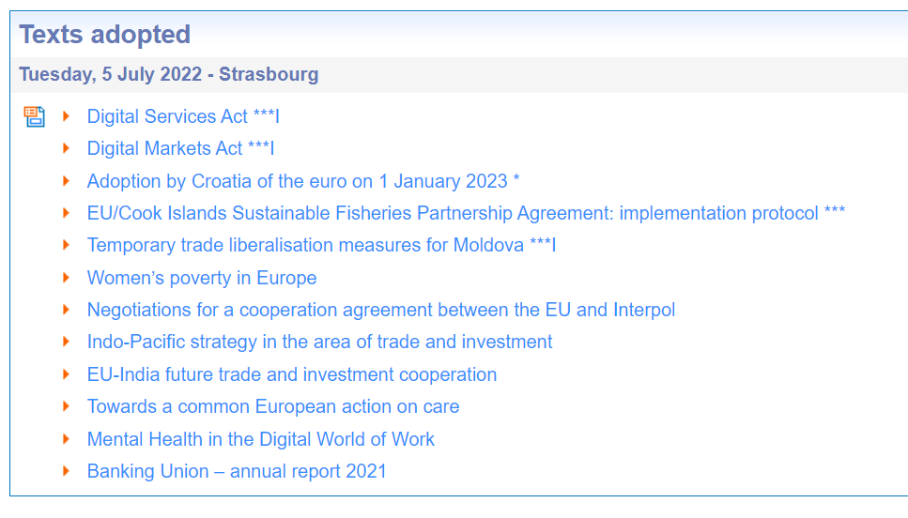
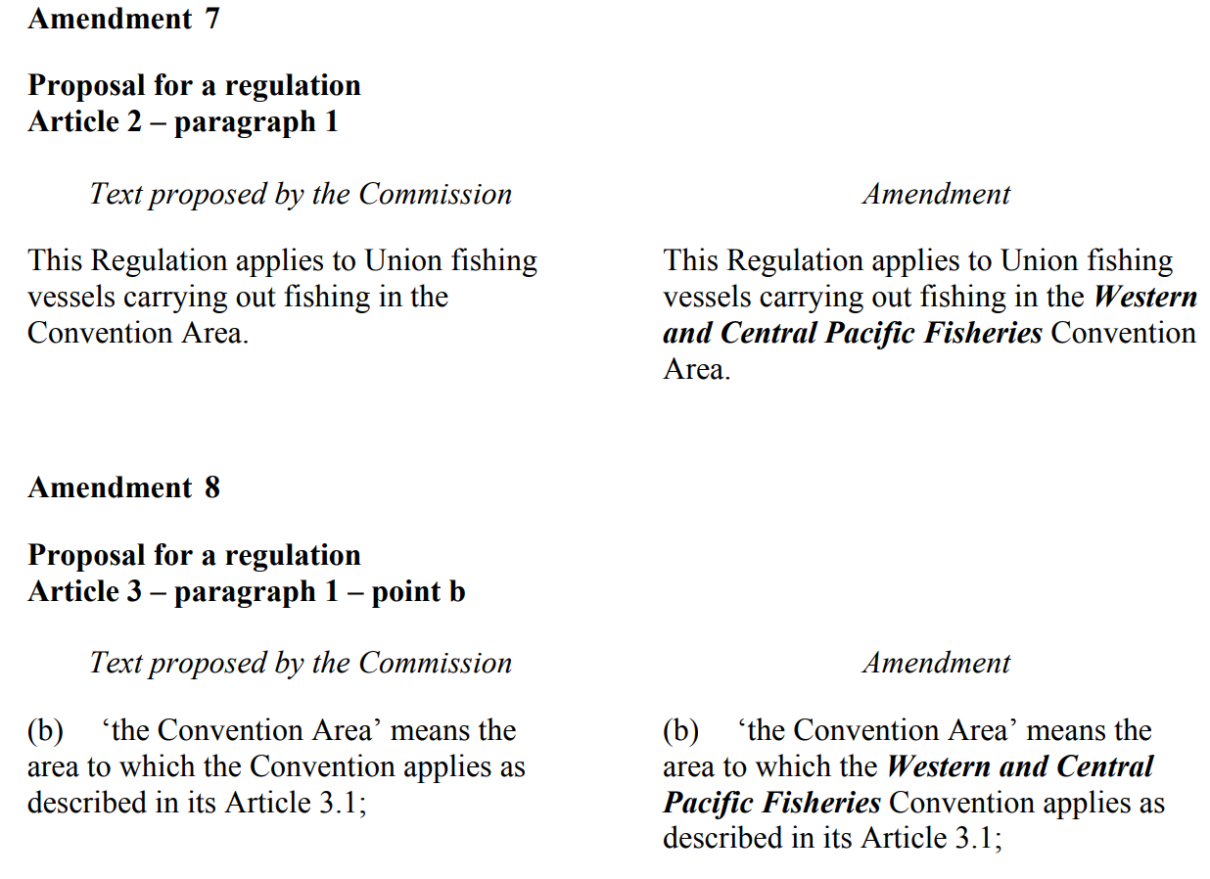
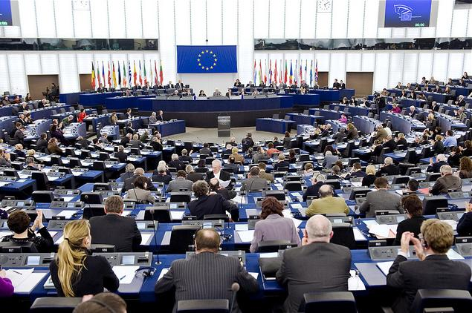
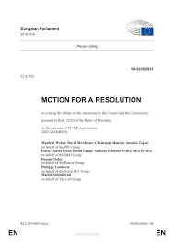
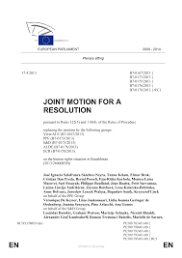
A very much simplified story
4. Our use cases
Parliament and Council are co-legislators.
Parliamentary committees and political groups examine proposals and draft amendments.
Reports and motions for resolutions tabled by Members, political groups or parliamentary committees are put to the vote in plenary.
Members can change the text by drafting and adopting amendments.
After the vote, the final adopted texts are published.
+
ELI-DL: Implementation by the European Parliament

Slide 11
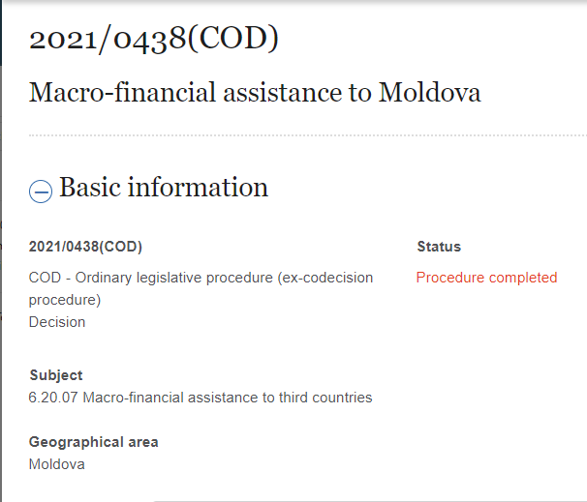
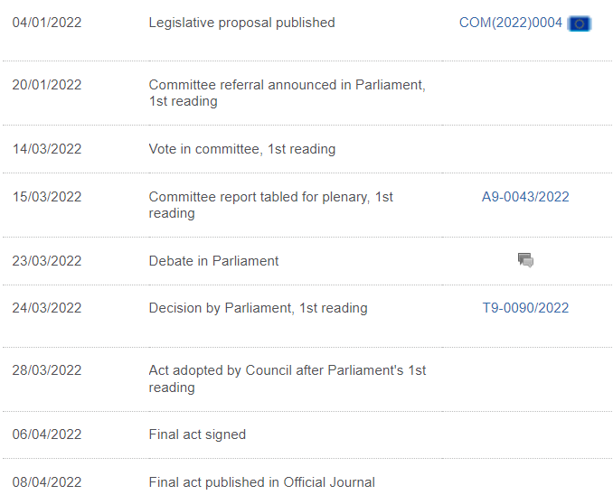
More complex reality
4. Our use cases
ELI-DL: Implementation by the European Parliament

Slide 12
ELI-EP knowledge graph
4. Our use cases

Slide 13
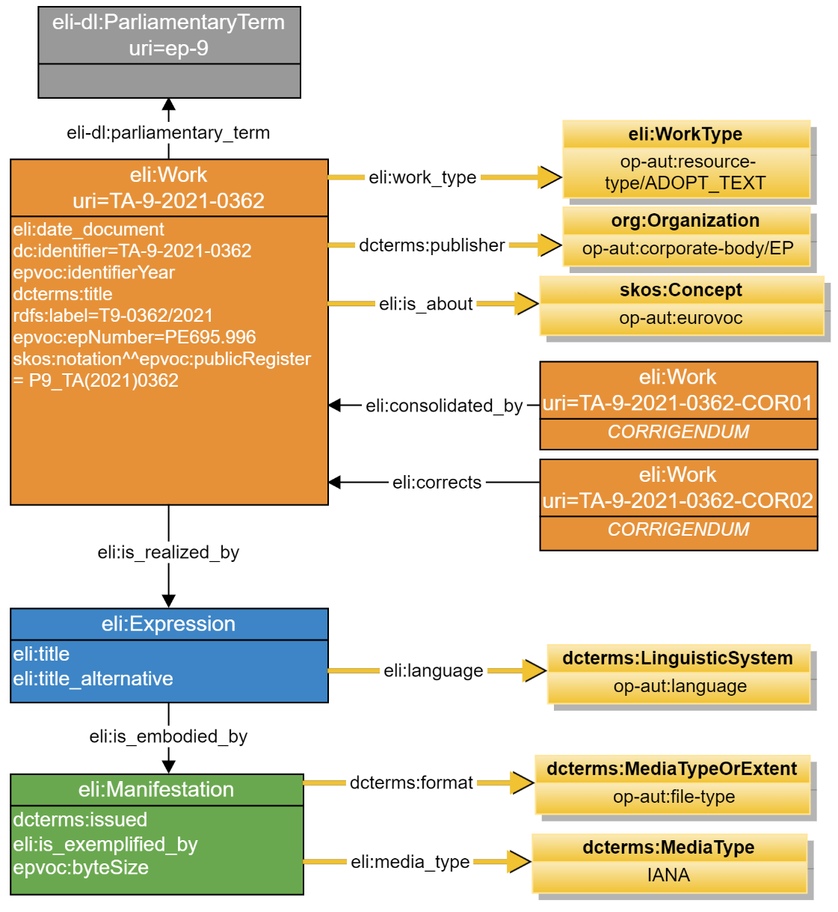
Documents – Adopted texts
4. Our use cases
During the current parliamentary term, the EP adopts its position on a specific topic.
... described with Eurovoc descriptors.
... existing in multiple EU languages.
... in different IT formats.
This adopted text was corrected by two corrigendum, one of them was consolidated in the adopted text.

Slide 14
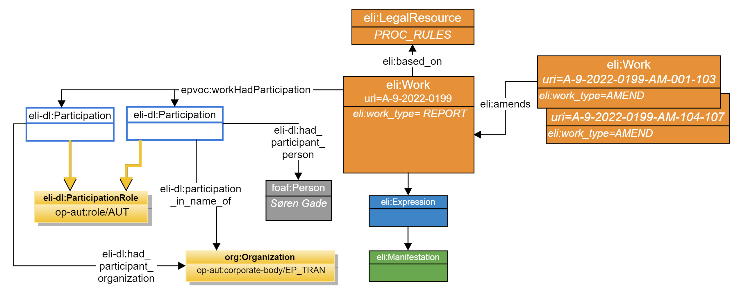
Documents – Report
4. Our use cases
Pursuant to rule 58 of EP rules of proecure, a report was tabled for plenary,
on a proposal from a rapporteur appointed by the committee responsible.
The committee responsible tabled amendments for consideration in plenary.

Slide 15
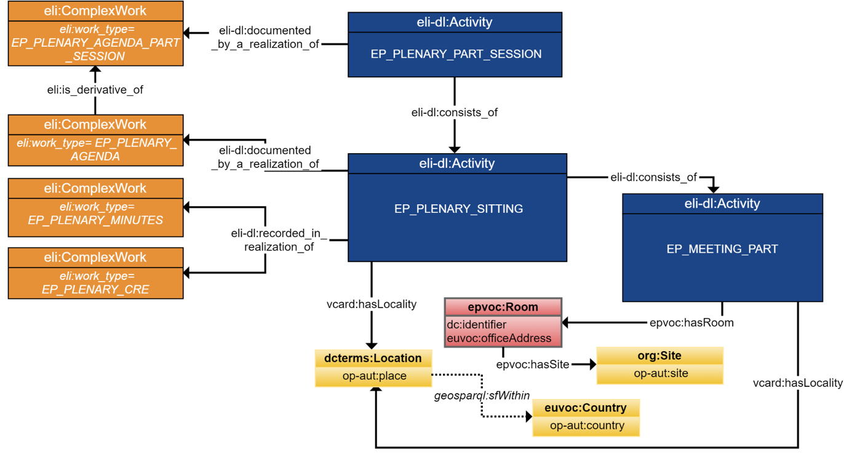
Events – Meetings
4. Our use cases
The Parliament meets monthly in part-sessions meetings.
Part-sessions are divided into one-day sittings, divided in several parts taking place in a specific location.
An agenda is drawn up for each part-session and each sitting, where foreseen points are documented.
The details of meetings are recorded in plenary session documents.

Slide 16
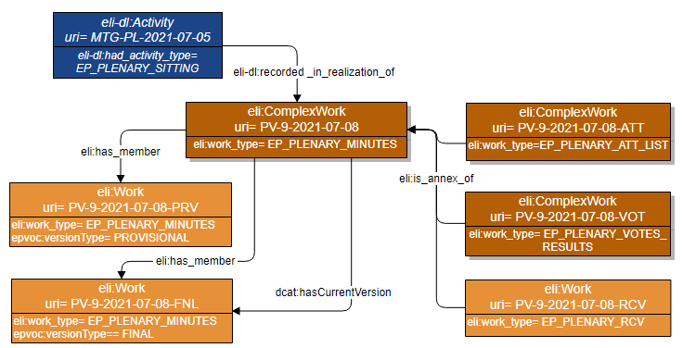
Plenary session documents
4. Our use cases
The minutes of each sitting give details of the exact proceedings and business of the day.
There are provisional and final versions of the minutes.
The attendant list and results of votes are also annexed to the minutes.

Slide 17
Thank you!
ELI-DL: Implementation by the European Parliament

Slide 18
ELI-DL: Implementation by the European Parliament

