Slide 1
Use case of ELI implementation in Spain
Interconnecting regional levels
ENDORSE | 2022
Follow up

Slide 3
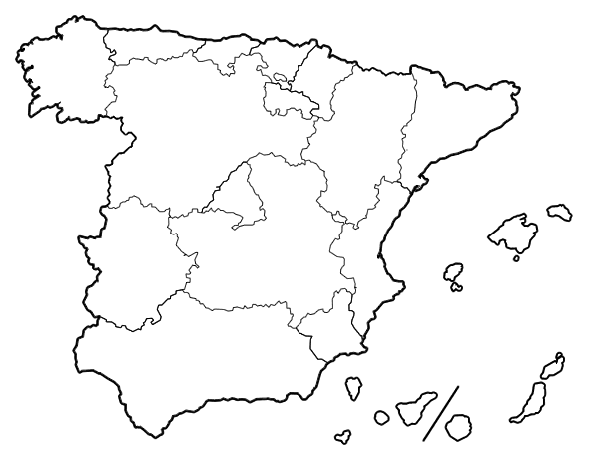
Multilevel governance
Notes:
17 Regions or Autonomous Communities: right to autonomy or self-government.
Each Autonomous Community: Parliament and a Government and legislative and regulatory powers.
Decentralized country, with a multilevel governance, quite similar to a federal state.

Slide 4
Multilingual context
Notes:
Multilingual context:
Spanish official language, the Constitution recognizes 4 other languages as a co-official in bilingual Communities (Basque, Catalan, Galician and Valencian).

Slide 5
01
02
03
Multipe legal information systems
Multiple dissemination services
Multiple oficial gazettes
Each entity runs their independently
Different technological situations, different models, not uniform or compatible metadata, nor links among them
Enriched legislative data bases, consolidated texts, electronic compilations of legislation and mail alerts
Notes:
It implies:
multiple official gazettes managed independently
multiple information systems with different technological developments and metadata
differents dissemination services (enriched legislative databases, consolidated texts, electronic compilations, mail alerts, …).
despite all this, State and Regional Acts and Regulations are deeply related and interlinked: users would need to access all the Spanish legislation, both State and autonomic, like a meaningful network. This global prospective is a key issue to improve the right to access to the law for everybody: judges, legal practitioners, companies and citizens.

Slide 7
ELI
Interconnect
Flexible
Gradual
No need to change current systems
Help network
Notes:
ELI was designed precisely to interconnect very different legal information systems at the European level, so it could work perfectly at the national scale too. Moreover, ELI is flexible, ELI is gradual, it doesn’t need for the running systems to be change, and ELI has an European help network and previous experiences of implementation to learn from.

Slide 9
Diversity and homogeneity together
Technical decisions
Notes:
Versatile nature of the ELI: forced us to make some technical decisions → not unilaterally: We wanted this diversity to be represented and at the same time to reach an homogeneity that would facilitate interoperability.
Therefore we decided to take these decisions in collaboration with the different territorial levels. To this effect, a working group, coordinated by the Official State Gazette, was created in which there were representatives from all the autonomous communities with a multidisciplinary approach composed of lawyers, information documentalists and IT specialists. For this part we found inspiration in ELI too.

Slide 10
We prefer
a collaborative process
based on joint work
National coordination
Notes:
This collaboration from the diversity has been the key factor for the success of the project. It has allowed us to take into account many aspects that would otherwise have been overlooked.

Slide 11
Working group
01
02
03
Design a solution that could fit everyone
Analyze existing situation and requirements
Mutual assistance during the implementation

Slide 12
Technical Specification
A common technical document that everybody can follow
1st ed. 2018
2nd ed. 2022
Notes:
The set of all these technical decisions → instruction manual for implementers and reusers: common technical document that everybody could follow. This document, prepared by the working group was formally adopted by the National Commission for e-government, as a Technical Specification.
First version for the State and autonomic legislation in 2018.
Second version includes local regulation, 2022.

Slide 13
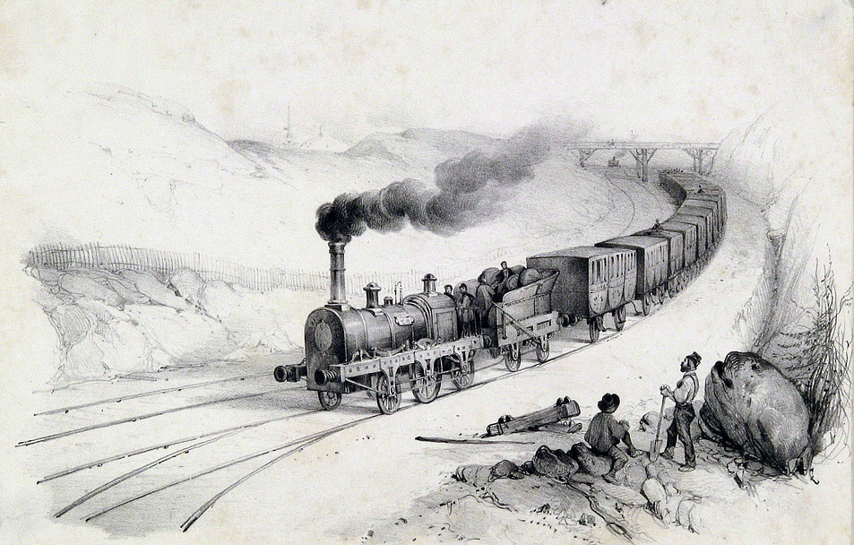
URI template
01
Unique URI template for all Spanish legislation (state, autonomic and local)
eli/{jurisdiction}/{type}/{year}/{month}/{day}/{number}/{version}/{version_date}/{language} /{format}
Notes:
The first: establish a single URI template for all legislation, regardless of the territorial level: State, autonomic or local, in order to guarantee mutual interoperability.
The ELI provides the possibility to choose between several URI components. By the Spanish use case, we have chosen all those necessary to identify any type of legislation, according to the common elements of all of them.
This is the ELI URI template that you will be able to find in any Spanish piece of legislation that has ELI assigned to it.

Slide 14
URI template
eli:jurisdiction identifies the public authority responsible for issuing the legal resource
Each legal information system has its own https: addrress
eli/{jurisdiction}/{type}/{year}/{month}/{day}/{number}/{version}/{version_date}/{language} /{format}
Notes:
The eli:jurisdiction component is particularly relevant. This property allows us to describe the authority responsible for issuing the legal resource, independently of the http:address and therefore regardless of where the resource is hosted.
Although the URI ELI presents the “name space” of the public Authority that makes the legal resource available, this name space is not enough to identify a legal resource: it is quite common that an information system offers legal resources from a different territorial level.

Slide 15
Set of metadata
02
An “interoperability core”:
minimum set of common metadata
Each entity is free to apply the other ELI metadata according to its needs and situations
Notes:
Secondly, the ELI ontology also offers a large number of properties: we have determined which were for us the minimum set, that each act should carry when Pillar II is to be implemented.
The common set of metadata, that has been agreed, are:
The metadata with information to build the URIs
The mandatory metadata according to the ELI ontology
The metadata with basic information about publication
The metadata that promotes interoperability, linking the different legal resources defined in our model.
Each entity is free to apply the other ELI metadata according to its needs and situations to improve its systems.

Slide 16
Controlled vocabulary
03
eli:jurisdiction
eli:type_document
eli:version
eli:language
Notes:
The third aspect to highlight in the technical specification is the definition of controlled vocabularies.
These tables unify the content that some metadata can take.
Moreover, it has been taking into account the rich multilingualism and ISO standards.
For jurisdiction, range or type document, language and version.

Slide 17
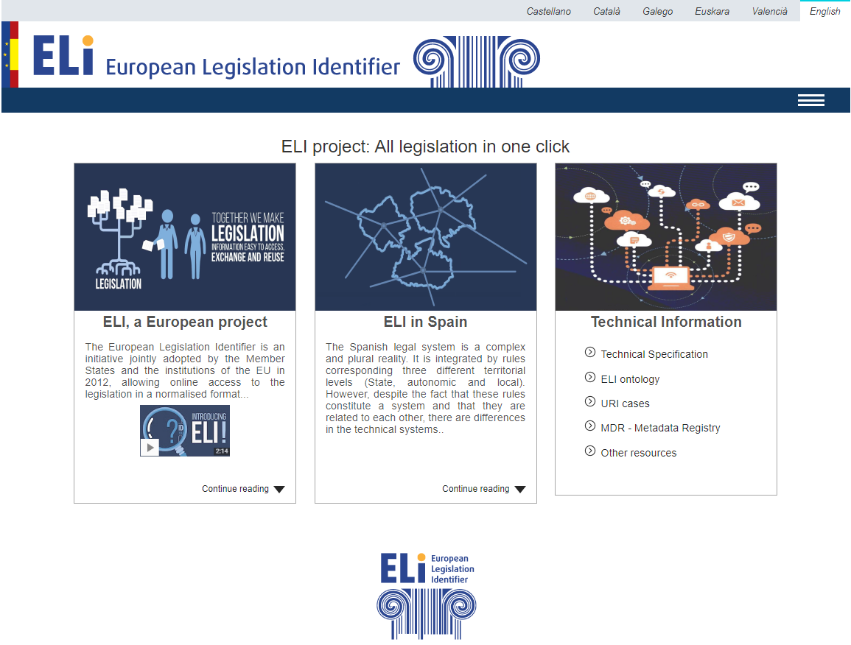
National Eli Registry
Notes:
All this work can be consulted in the website elidata.es.
Developed as a National ELI registry.
Available in English.
On this page you can find general information about the ELI project for citizens, and we share all technical information for implementers and reusers.
Full text of the technical specification.
Conceptual model for some special cases.
The metadata that we have set as a minimum.
The possibility to download our national authority tables in XML and RDFskos.
Sometimes we have an unique authority table, like this, but other times we have distinguished an specific one for local regulations.
On the other side, when there was a suitable standard for our tables, we have used it. This way, for jurisdiction, we chose ISO 3166 alfa 2. For local entities, we have added to the ISO, the numbering code of the national Local Entities Registry, that is an existing national authority table that identifies each Province, Island or municipality.
In other occasions, it has been necessary to adapt the general standard. For instance, in the case of the language.
Sometimes, some Autonomous Communities use bilingual documents, so we have adapted ISO 639-3, creating new values with the combination of the languages involved.
At the bottom of the website can be consulted the implementations carried out by each territorial level.

Slide 18
01
Problem
02
Solution design
03
Implementation

Slide 19
Eli territory
Notes:
Each Autonomous Community is implementing this solution according with their situation and means, although the commitment is to implement asap.
Currently the State and 9 Autonomous Communities have assigned ELI to their rules. In addition, apart from the State, 7 of them have taken the step of developing pillar II and III.
As for local regulations: there are more than 8.000 municipalities, characterized by the wide variety in terms of size, economic activity and geographic location, so the purpose of the Specification is just to offer an implementation model. This way, those entities that want to apply ELI, can do it in a harmonized and coordinated way with the State and the Autonomous Communities

Slide 20
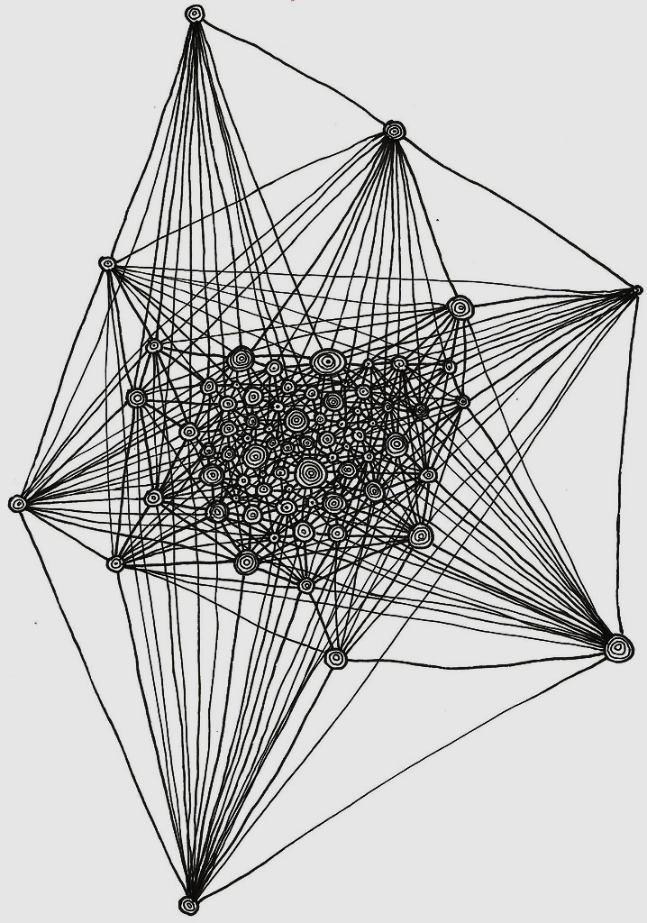
Result

Slide 21
Results
1. Linking publications
2. Linking different versions
3. Developing new services
4. Improving utility for reusers
5. Opening bigger possibilities for metasearch engines
6. …
Notes:
As a result, we have already a fertile ground for interoperability, interconnection and reuse, with the possibility of:
Linking the publication made by different official journals of the same legal resource.
Linking initial and consolidated versions when they are available in different information systems.
Developing future services, taht can give access to legislation issued by different territorial levels.
And with the possibility of opening bigger possibilities for reusers and metasearch engines
All of this just for the purpose of Improving citizens right to access to legislation.
Some examples:
https://www.boe.es/eli/es-mc/l/2022/07/28/6
https://www.borm.es/eli/es-mc/l/2022/07/28/6
https://docm.jccm.es/docm/eli/es-cm/o/2022/09/09/190
https://www.legegunea.euskadi.eus/eli/es-pv/l/2022/06/30/9/dof/spa/html/
https://dogv.gva.es/es/eli/es-vc/l/2022/07/22/3/
https://portaljuridic.gencat.cat/eli/es/l/2007/07/03/14
https://www.caib.es/eboibfront/eli/es-ib/l/2022/06/06/2/dof/spa/html
http://www.boa.aragon.es/#/elidata
http://doe.juntaex.es/eli/es-ex/d/2022/04/27/44/dof/spa/pdf
https://bocyl.jcyl.es/eli/
https://www.zaragoza.es/sede/servicio/normativa/eli/es-ar-01502973

Slide 22
Achievements
(and learnings)
Keep working until full implementation
New implementation, new learnings
Challenges and new opportunities to cooperate

Slide 23
proyecto.eli@boe.es
www.elidata.es
To be continued…
ENDORSE | 2022
Follow up

