Slide 1
ELI + ELI-DL map walkthrough
ENDORSE followup event – 19/10/2022
ELI Taskforce / Thomas Francart

Slide 2
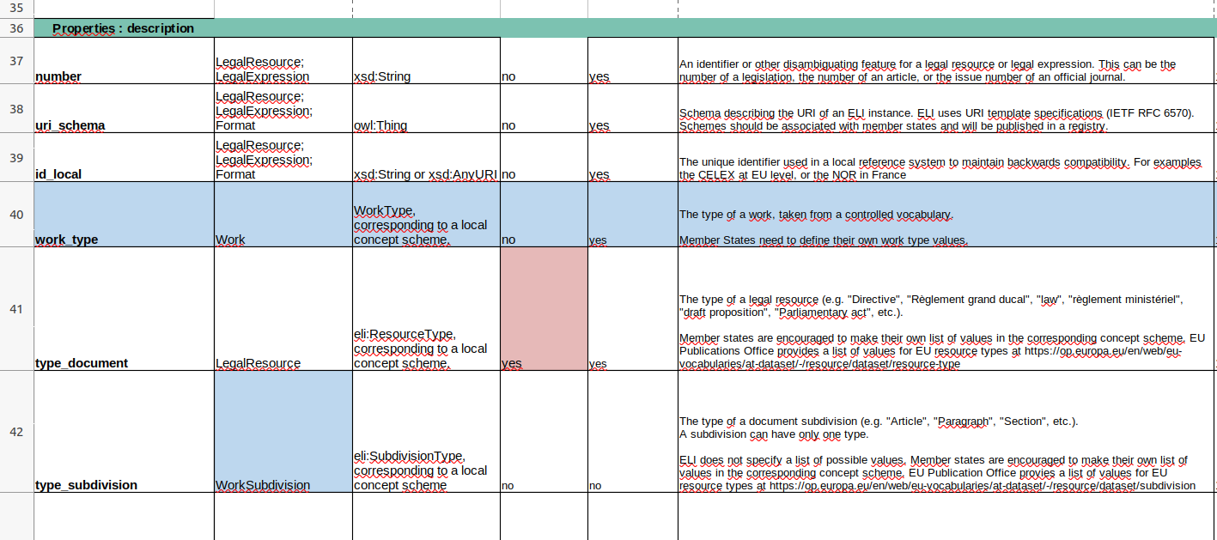
ELI + ELI-DL are description frameworks formalized as ontologies
ELI : https://op.europa.eu/en/web/eu-vocabularies/dataset/-/resource?uri=http://publications.europa.eu/resource/dataset/eli
ELI-DL : https://joinup.ec.europa.eu/collection/eli-european-legislation-identifier/solution/eli-ontology-draft-legislation-eli-dl/release/v2
Start by looking at Excel files + diagrams

Slide 3
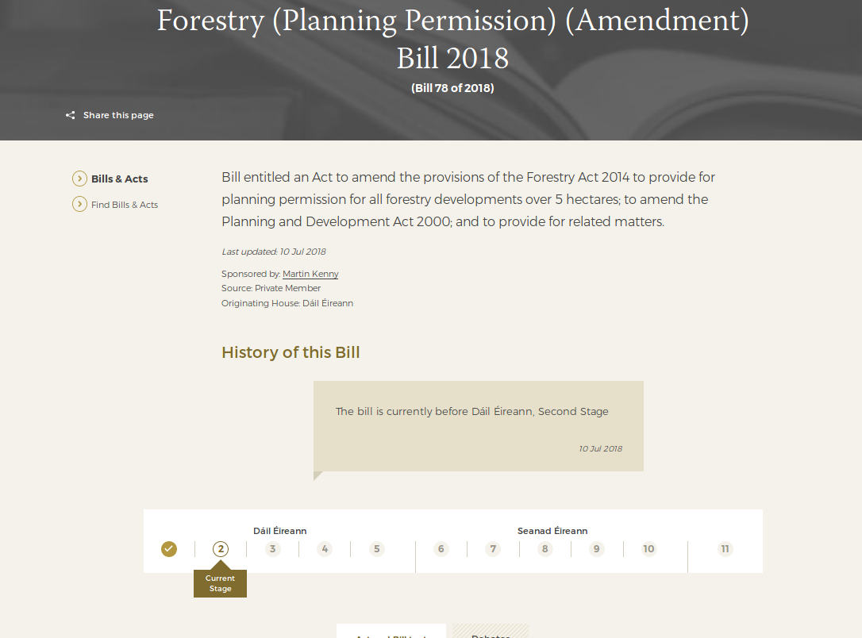

Slide 4
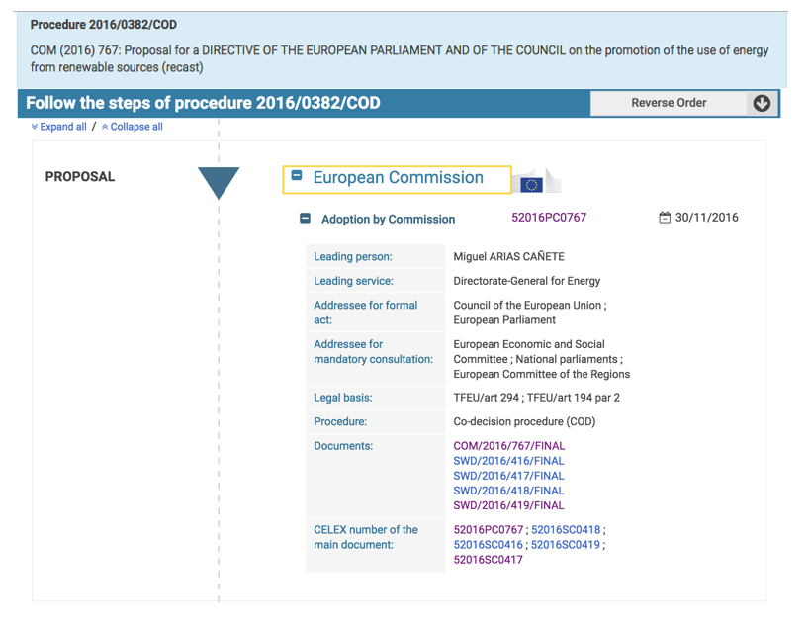

Slide 5
ELI + ELI-DL is a descriptive framework but is not prescriptive.
It provides « semantic building blocks » to describe documents and activities, but does impose how they must be described.

Slide 6
ELI + ELI-DL describe documents and activities / events.
Event-based model
Timeline of activities connected to documents

Slide 7
Documents
Activities

Slide 8
The document description is done with a model based on FRBR.
Work > Expression (linguistic variant) > Format > File
It adapts to multilingual + multiformat contexts
Also deals with versioning of documents
The subdivisions of documents can also be described.

Slide 9
Documents
All documents described in FRBR
(and their subdivisions)
Work (version)
(= content)
Expression
(= text)
Expression
(= text)
Expression
(= text)
Expression
(= text)
Expression
(= text)
Manifestation
(= file/format)
Activities

Slide 10
The scope of ELI is on Legislative acts.
The scope of ELI-DL is on documents created during the drafting of the legislation.
A more generic level is also provided to describe any documents (not acts, and not draft-legislation-related) .

Slide 11
Documents
All documents described in FRBR
(and their subdivisions)
Legislation docs.
Draft legislation docs.
Work (version)
(= content)
Expression
(= text)
Laws
repeals,
amends,
corrects,
based on,
etc…
Expression
(= text)
Version of draft
Expression
(= text)
Decree
Amendments
Expression
(= text)
Directive
Expression
(= text)
Manifestation
(= file/format)
etc…
Reports, opinions, etc.
Activities

Slide 12
Activities can be linked because :
They consist of other sub-activities
Hierarchy of activities (« vote takes place during meeting »)
They are motivated (caused by) other activities
Causal, non hierarchical relationship

Slide 13
Documents
All documents described in FRBR
(and their subdivisions)
Legislation docs.
Draft legislation docs.
Work (version)
(= content)
Expression
(= text)
Laws
repeals,
amends,
corrects,
based on,
etc…
Expression
(= text)
Version of draft
Expression
(= text)
Decree
Amendments
Expression
(= text)
Directive
Expression
(= text)
Manifestation
(= file/format)
etc…
Reports, opinions, etc.
Activities
consist of
motivated by

Slide 14
A special kind of Activity is the Process itself.
The Process corresponds to an entire « Bill » / « Dossier parlementaire », from initiation to signature.

Slide 15
Documents
All documents described in FRBR
(and their subdivisions)
Legislation docs.
Draft legislation docs.
Work (version)
(= content)
Expression
(= text)
Laws
repeals,
amends,
corrects,
based on,
etc…
Expression
(= text)
Version of draft
Expression
(= text)
Decree
Amendments
Expression
(= text)
Directive
Expression
(= text)
Manifestation
(= file/format)
etc…
Reports, opinions, etc.
consist of
Activities
Processes
consist of
motivated by

Slide 16
Activities and Processes can be specialized in legislative activities and legislative processes.
(Which was the focus of ELI-DL in its first version, before broadening the scope to non-legislative activities)

Slide 17
Documents
All documents described in FRBR
(and their subdivisions)
Legislation docs.
Draft legislation docs.
Work (version)
(= content)
Expression
(= text)
Laws
repeals,
amends,
corrects,
based on,
etc…
Expression
(= text)
Version of draft
Expression
(= text)
Decree
Amendments
Expression
(= text)
Directive
Expression
(= text)
Manifestation
(= file/format)
etc…
Reports, opinions, etc.
consist of
Activities
Processes
Can be specialized in legislative activities & legislative processes
consist of
motivated by

Slide 18
An important aspect of the model is the linkage of Activities and Documents :
Documents can be input or output of activities
Activities can be recorded in documents
Activities (and draft-legislation documents) can foresee a change in legislation
Processes can group all the documents issued within the process

Slide 19
Documents
All documents described in FRBR
(and their subdivisions)
Legislation docs.
foresees changes on
Draft legislation docs.
Work (version)
(= content)
Expression
(= text)
Laws
repeals,
amends,
corrects,
based on,
etc…
Expression
(= text)
Version of draft
Expression
(= text)
Decree
Amendments
Expression
(= text)
Directive
Expression
(= text)
Manifestation
(= file/format)
etc…
Reports, opinions, etc.
foresees changes on
based on
creates
recorded in
consist of
groups
Activities
Processes
Can be specialized in legislative activities & legislative processes
consist of
motivated by

Slide 20
Another important aspect is the description of the participants in Activities, with their roles.

Slide 21
Documents
All documents described in FRBR
(and their subdivisions)
Legislation docs.
foresees changes on
Draft legislation docs.
Work (version)
(= content)
Expression
(= text)
Laws
repeals,
amends,
corrects,
based on,
etc…
Expression
(= text)
Version of draft
Agents
Expression
(= text)
Decree
Amendments
Expression
(= text)
Directive
Person
Expression
(= text)
Manifestation
(= file/format)
etc…
Reports, opinions, etc.
Organization
foresees changes on
based on
creates
recorded in
consist of
groups
Activities
Processes
participant
role
Can be specialized in legislative activities & legislative processes
consist of
motivated by

Slide 22
Activities in general are described « in the past ».
However there is also a need to describe foreseen (future) activities, as they are documented in meeting agendas, etc.
Actual activities can be linked to the foreseen activity that they executed.

Slide 23
Documents
All documents described in FRBR
(and their subdivisions)
Legislation docs.
foresees changes on
Draft legislation docs.
Work (version)
(= content)
Expression
(= text)
Laws
repeals,
amends,
corrects,
based on,
etc…
Expression
(= text)
Version of draft
Agents
Expression
(= text)
Decree
Amendments
Expression
(= text)
Directive
Person
Expression
(= text)
Manifestation
(= file/format)
etc…
Reports, opinions, etc.
Organization
foresees changes on
documented by
based on
creates
recorded in
consist of
groups
Activities
Processes
Foreseen activities
As described in agendas
participant
role
Can be specialized in legislative activities & legislative processes
consist of
motivated by
executed

Slide 24
Two more specific kind of activities deserve specific description:
The Votes, with the recording of the vote decision and the individual voters
The EU Directive Transposition processes

Slide 25
Documents
All documents described in FRBR
(and their subdivisions)
Legislation docs.
foresees changes on
Draft legislation docs.
Work (version)
(= content)
Expression
(= text)
Laws
repeals,
amends,
corrects,
based on,
etc…
Expression
(= text)
Version of draft
Agents
Expression
(= text)
Decree
Amendments
Expression
(= text)
Directive
Person
Expression
(= text)
Manifestation
(= file/format)
etc…
Reports, opinions, etc.
Organization
voter
(favor, against, abstention)
foresees changes on
documented by
based on
creates
recorded in
consist of
groups
Activities
Votes
Processes
Foreseen activities
As described in agendas
participant
Transposition processes
role
Can be specialized in legislative activities & legislative processes
consist of
motivated by
executed

Slide 26
ELI contains the base definition of document structure, agents, as well as a detailed model for legislation documents.
ELI-DL covers activities and draft legislation documents.

Slide 27
ELI
Documents
All documents described in FRBR
(and their subdivisions)
Legislation docs.
foresees changes on
Draft legislation docs.
Work
(= content)
Expression
(= text)
Laws
repeals,
amends,
corrects,
based on,
etc…
Expression
(= text)
Version of draft
Agents
Expression
(= text)
Decree
Amendments
Expression
(= text)
Directive
Person
Expression
(= text)
Manifestation
(= file/format)
etc…
Reports, opinions, etc.
Organization
voter
(favor, against, abstention)
foresees changes on
documented by
based on
creates
recorded in
consist of
groups
Activities
Votes
Processes
Foreseen activities
As described in agendas
participant
ELI-DL
Transposition processes
role
Can be specialized in legislative activities & legislative processes
consist of
motivated by
executed

Slide 28
ELI + ELI-DL provides an extensible
framework for semantic interoperability of legislation-related documents and activities.
Semantic annotations of webpages
Open data publishing
Data-centric architectures

Slide 29
Thank you ! Questions ?

